Slide 1
Diversity and Aging in Korea: How Adult Education and Learning(ALE) Support Older (Im)migrants to their Later Lives
1/45
Romee Lee
(lecturer, Dept of Education, Korea National Open University)
2023. 12. 16.

Slide 2
The personal is political (1)
2/45

Slide 3
The personal is political (2)
3/45

Slide 4
Ⅰ. INTRODUCTION
4/45
Older people x migration x learning

Slide 5
Older people
5/45
Educational Gerontology
… study and practice of instructional endeavors for and about aged and aging individuals.
EG has 3 aspects:
Education and learning of older people themselves;
educational endeavors of everyone who want to understand older people;
Knowledge, skills and attitude of persons who are working or intend to be employed in serving older people in professional or paraprofessional capacities. (Peterson, 1976: 62)
Peterson, D. A. (1976). Educational gerontology: The state of the art. Educational Gerontology, 1(1), 61-73.

Slide 6
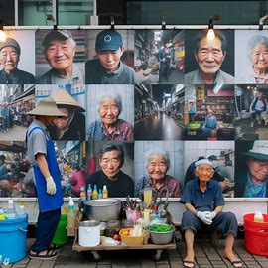
migration
6/45
Intersection of older people and
migration
in Korea

Slide 7
Korean society of Educational Gerontology
7/45
… and its journal - no single paper regarding older migrants in Korea

Slide 8
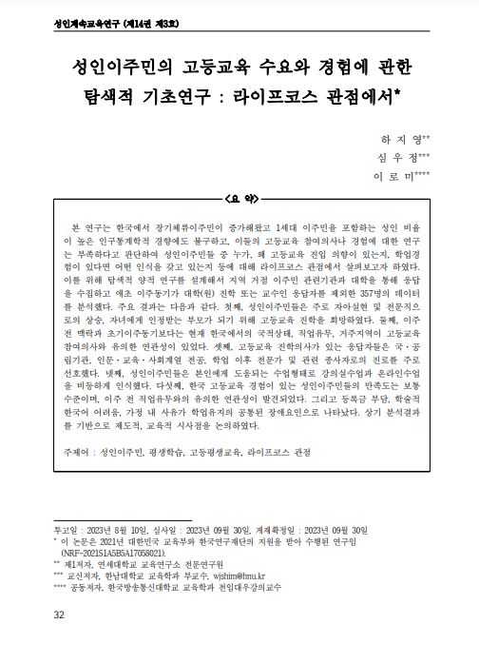
The Start of this research
8/45
Ha, J., Shim, W, & R. Lee (2023). An Exploratory Study on Adult Immigrants’ Demand and Experience for Korean Higher Education: From the Lifecourse Perspective. Korean Journal of Adult & Continuing Education Studies.14(3). 31-61.
… and some interviewees shared their worries about their later adulthood.

Slide 9
9/45
II. 3+1 Groups
…Of older migrants in korea

Slide 10
Definition
10/45
Older migrant is any foreign-born person who either moved to the country of destination via, for example, a family reunification programme, at age 65 or older, moved in the past and then reached the retirement age in the country of destination, or was displaced by conflict at 65 age older or reached retirement age while displaced.

Slide 11
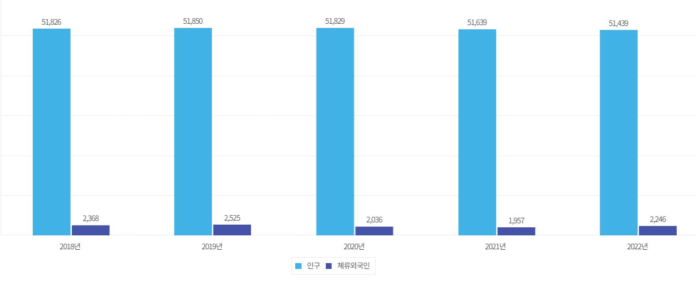
11/45
Increasing numbers of migrants
법무부 출입국·외국인정책본부(2022) 자료

Slide 12
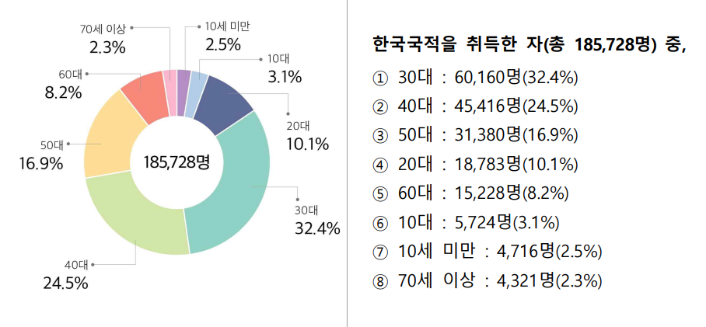
NOW, Migrants in korea over 60: 170,000
12/45
Naturalized Citizen
Foreigners
출처: 2019 지방자치단체외국인현황, 행정안전부
… and there will be a lot more soon!

Slide 13
1st Group
13/45
1st generation migrants
https://www.bbc.com/news/world-asia-57716704

Slide 14
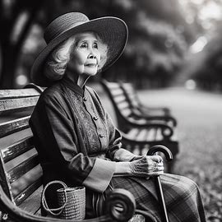
Their risky future
14/45
Considered to have Low SES
Have less social networks
Stayed at home or Worked in low-skilled sectors
Difficulties in language and culture
Depend mainly on their partner’s income
May have longer ‘widowhood’

Slide 15
2nd Group
15/45
Parents of Immigrants
https://m.khan.co.kr/national/national-general/article/202102131120001

Slide 16
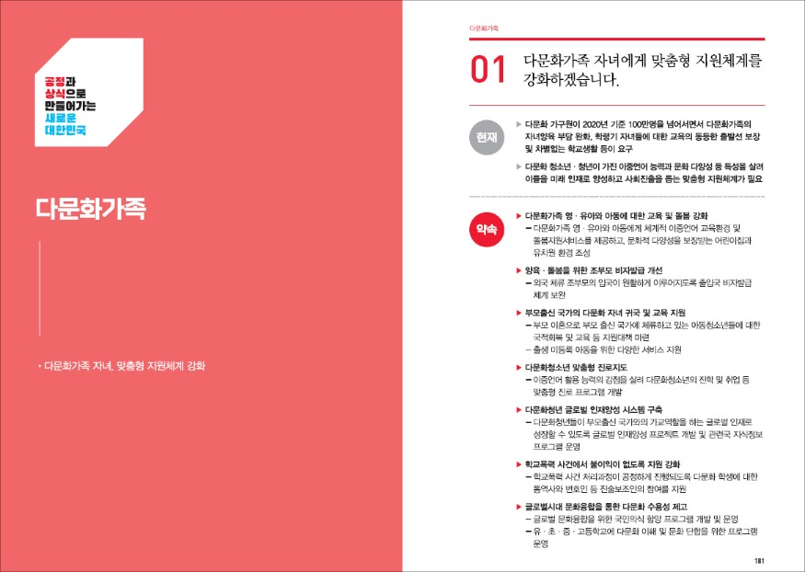
Family-based immigrant visas (F-1-5)
16/45
They now
can stay longer
upto 4 year 10 month
Notes:
.

Slide 17
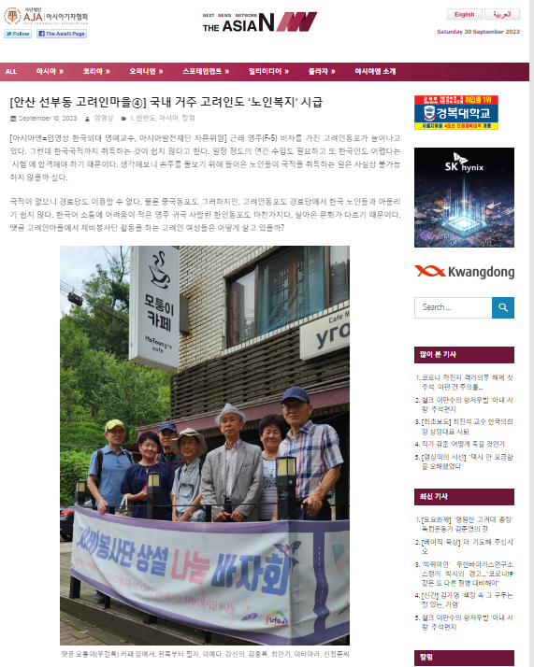
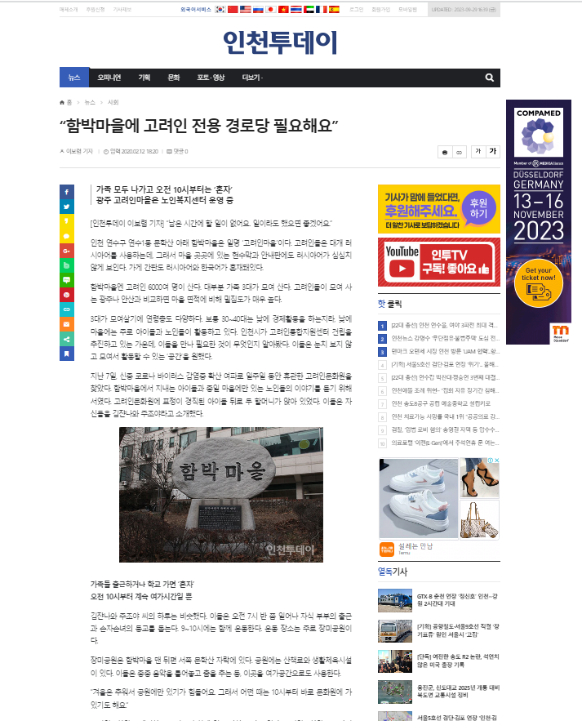
Lonely and boring life in korea
17/45
Ansan
Incheon
http://kor.theasian.asia/archives/345776
https://www.incheontoday.com/news/articleView.html?idxno=120562

Slide 18
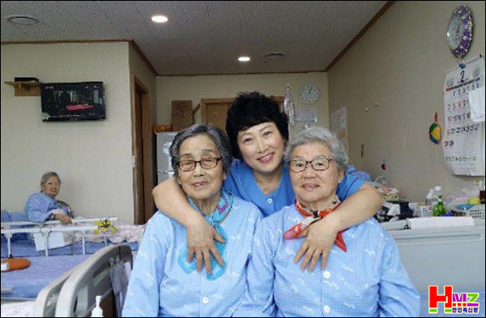
3rd Group
18/45
Ethnic Korean Chinese Women who work in caregiving sector
http://www.hmzxinwen.com/news/22237

Slide 19
F4 visa holders in private caregiving
19/45
No specific data on the number of ethnic Koreans working in private caregiving
Caring elderly or disabled in Korea
People providing care for family members or friends may not be accounted for in any official statistics.

Slide 20
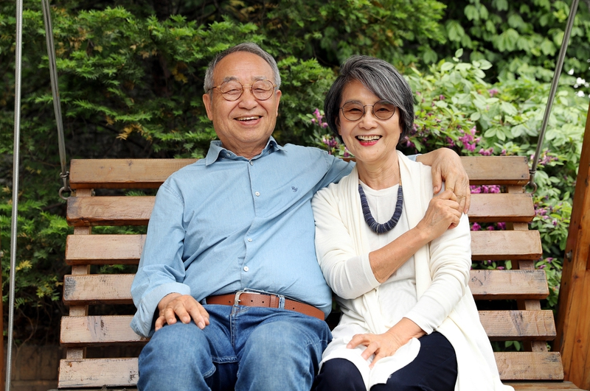
4th Group
20/45
Returning
Immigrants
https://img.hani.co.kr/imgdb/resize/2019/0524/53_1558748593_00502619_20190524.JPG

Slide 21
Return migration
21/45
Reverse immigration rush to cover medical expenses for elderly Koreans who have immigrated

Slide 22
But they are Returning to Korea due to loneliness
22/45
https://www.ytn.co.kr/_ln/0104_202204170208166134

Slide 23
23/45
kicked out of McDonald’s in N.Y.
https://www.nytimes.com/2014/01/15/nyregion/fighting-a-mcdonalds-for-the-right-to-sit-and-sit-and-sit.html

Slide 24
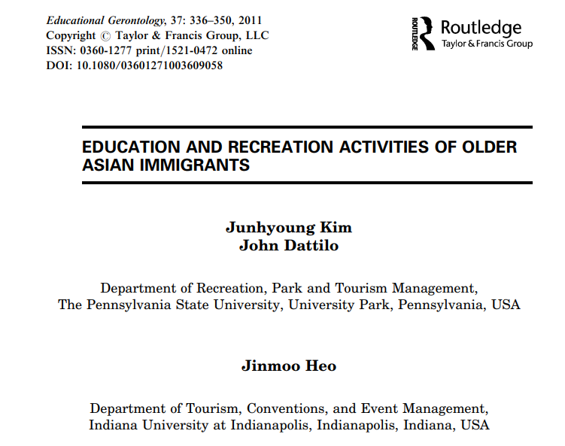
Older Asians in the u.s. & their lives
24/45
For New York City's aging immigrants, it can be hard to create a community | The World from PRX
Not good at speaking English & enjoying their free time with others

Slide 25
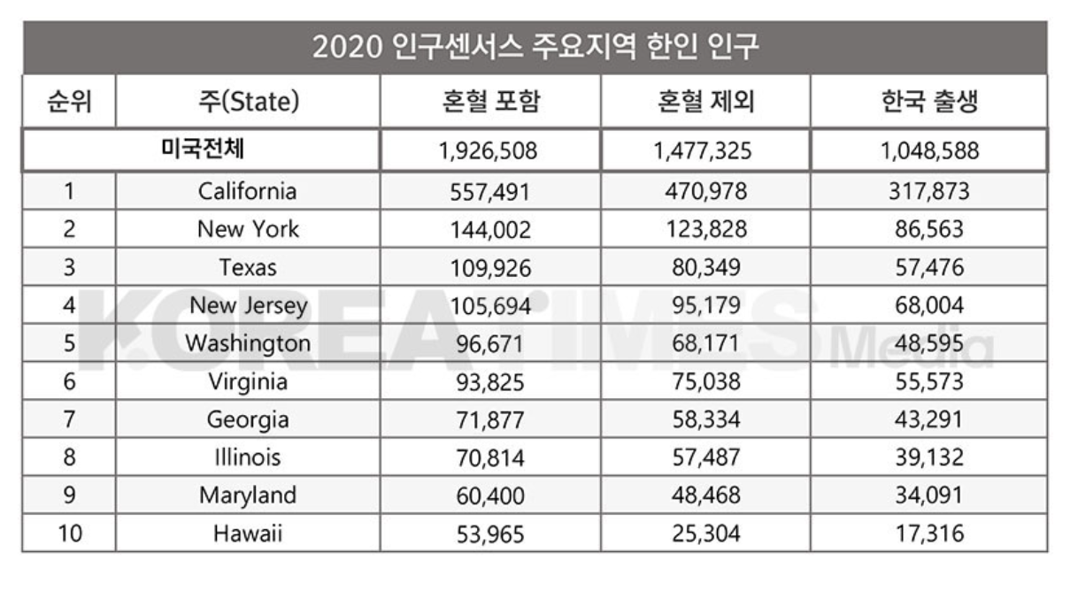
260,000 Koreans over 65 in the u.s.
25/45
2,000 from the U.S. are returning to Korea every year
http://koreatimestx.com/archives/17439

Slide 26
26/45
III. Core tHEMES
Human rights, Intersectionality, diversity and multicultural competence

Slide 27
1. HUMAN RIGHTS for older migrants
27/45
Independence
Self-Fulfillment
Dignity
Participation
Care
1
United Nations Principles of Older Persons
2
3
4
overarching theme is human rights
5

Slide 28
And… Ageism in Korea
28/45
Ageism
is a form of discrimination based on age, often affecting older people negatively.
Ageism in Korea
Many older people have difficulty finding jobs or face abuse and violence due to their age

Slide 29
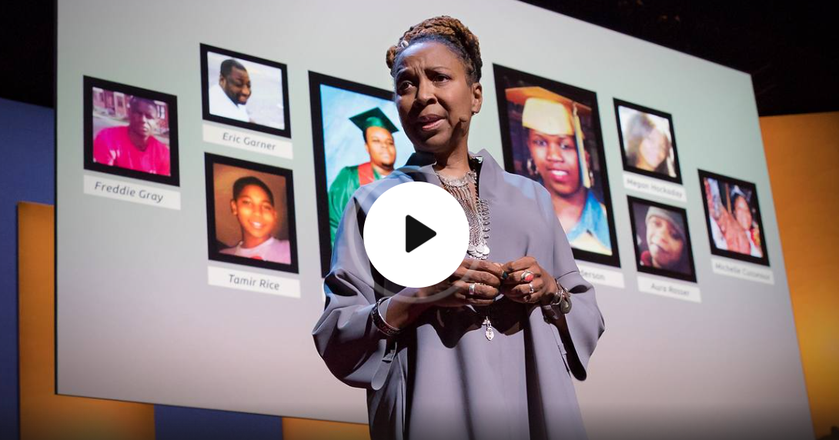
2. Diversity and INTERSECTIONALITY
29/45
Intersection of age, race/ethnicity, culture and gender(!)
Korea’s increasing ageism
And gender…
https://www.ted.com/talks/kimberle_crenshaw_the_urgency_of_intersectionality?language=ko

Slide 30
Immigrant older women and caring
30/45
Private sphere: multicultural families
Caring children& older adults
Public sphere: care sector
90% of private caregivers
Feminization of migration

Slide 31
31/45
III. Core social iSSUES
Human rights, Intersectionality, diversity and multicultural competence

Slide 32
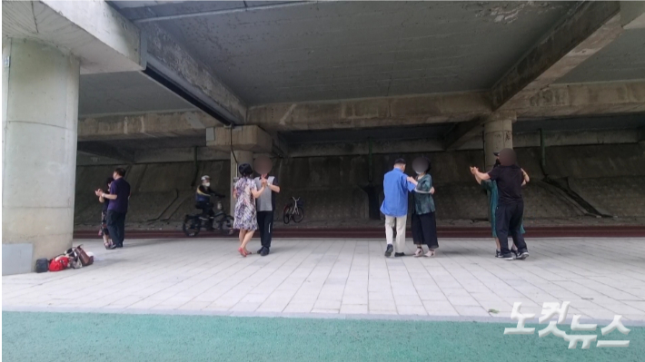
'group social dance'... Chinese cultural life vs. eyesore
32/45
1. (Unhappy and boring) Lives of older migrants IN MULTICULTURAL SOCIETY

Slide 33
2. Caring IN MULTICULTURAL SOCIETY ( that is not equally distributed)
33/45
They need caring since they are old
Many of them are still offering care either in their families and in Korean labour market

Slide 34
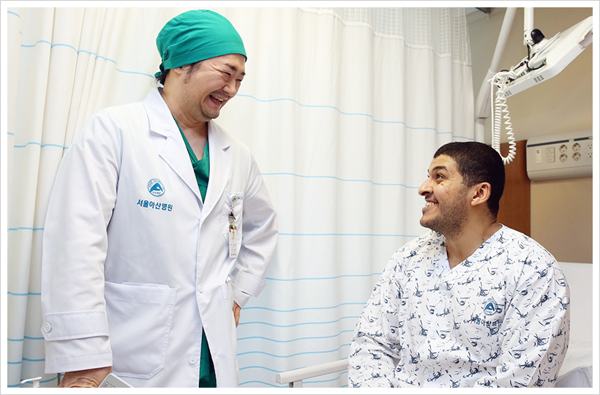
3. (lack of) CULTURAL COMPETENCES of professionals or para-professionals
34/45
Cultural competence is defined as the process by which individuals and systems respond respectfully and effectively to people of all cultures, languages, classes, race, ethnic backgrounds, religions, and other diversity factors in a manner that recognizes, affirms, and values the worth of individuals, families, and communities and protects and preserves the dignity of each.
https://amc.seoul.kr/asan/depts/ihc/K/bbsDetail.do?menuId=1393&contentId=264692

Slide 35
35/45
III. Adult education and learning
What should we do?

Slide 36
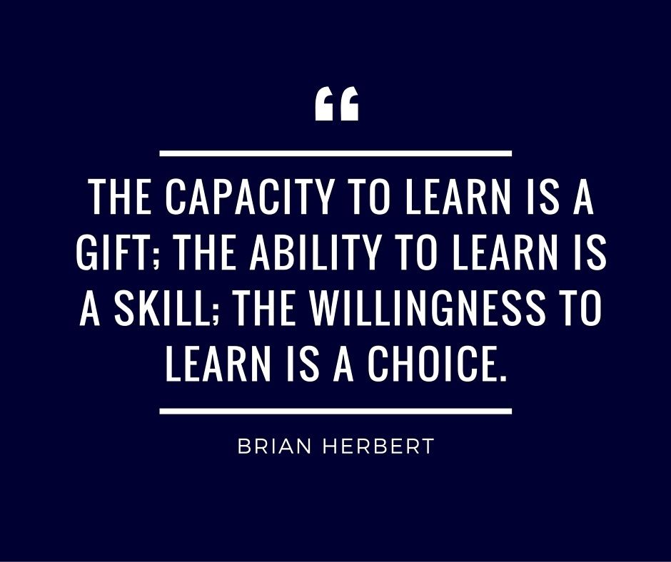
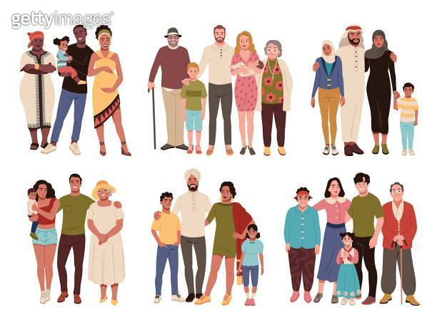
36/45
Whose learning is needed?
https://phase-hitchin.org/blog/keep-learning

Slide 37
1. Supporting Lifelong of diverse older people
37/45
lifelong learning and immigrant seniors’ everyday learning
How prepared is our society for the care of various groups of elderly people?
supporting lifelong learning of diverse older people

Slide 38
LIFELONG LEARNING
38/45
the value of the unequivocal promotion of community-based non-formal lifelong learning opportunities for developing inclusive, equitable and caring active ageing societies
(Narushima et al., 2018).
“Older adults are often excluded from adult learning statistics as they are assumed to be the post-work generation.” “Lifelong learning has not been fully integrated into active aging discourse.” (Zhu & Zhang, 2019).

Slide 39
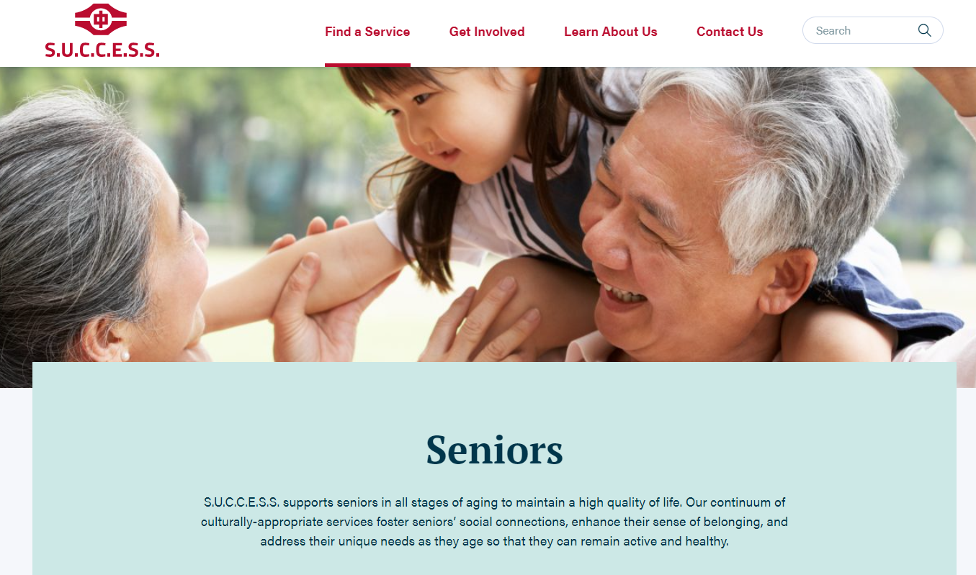
Case: support of LIFELONG LEARNING for diverse seniors
39/45
In Canada, all seniors are invited to the spaces for learning in the communities where they live whether they have or don’t have Canadian citizenship
https://successbc.ca/service-categories/seniors

Slide 40
How to Improve Cultural Competence in (Health and long-term) Care
40/45
cultural competence of professionals
https://publichealth.tulane.edu/blog/cultural-competence-in-health-care/

Slide 41
2. Learning how to live together
41/45
Racism, Ageism out and more
Ageism out
Racism out
Understanding people from other cultures
Racial and Cultural diversity as a new social issue
Xenophobia & Gerontophobia
Ethnonationalism

Slide 42
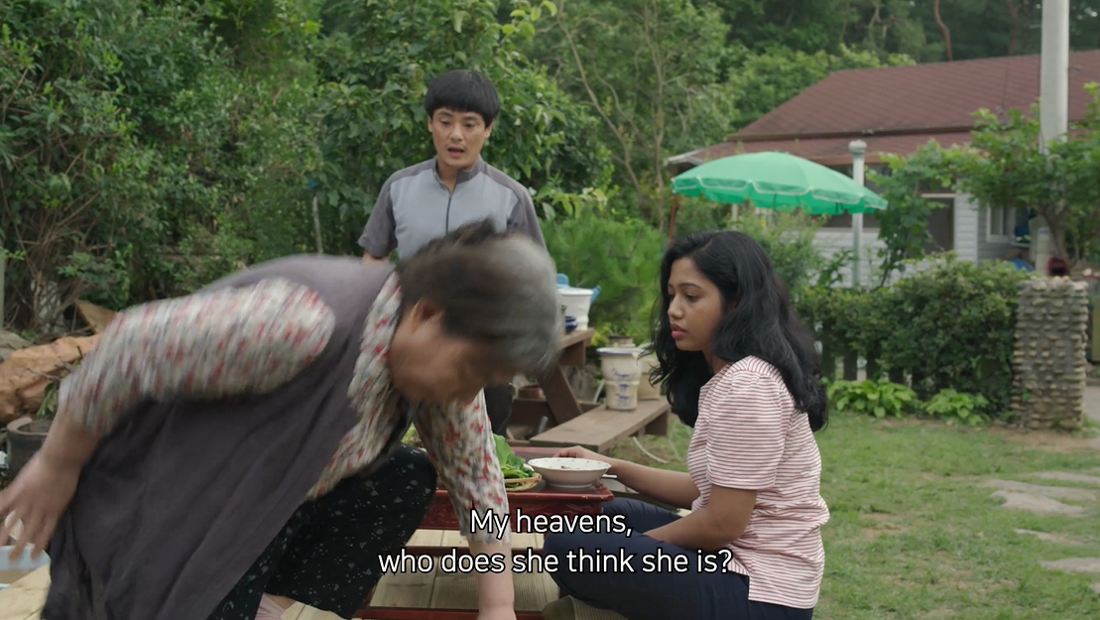
Korean people are not necessarily ready to live together
42/45
https://www.mk.co.kr/news/culture/view/2022/03/203639/

Slide 43
43/45
Ⅶ. Final thoughts
Is Korea disappearing?

Slide 44
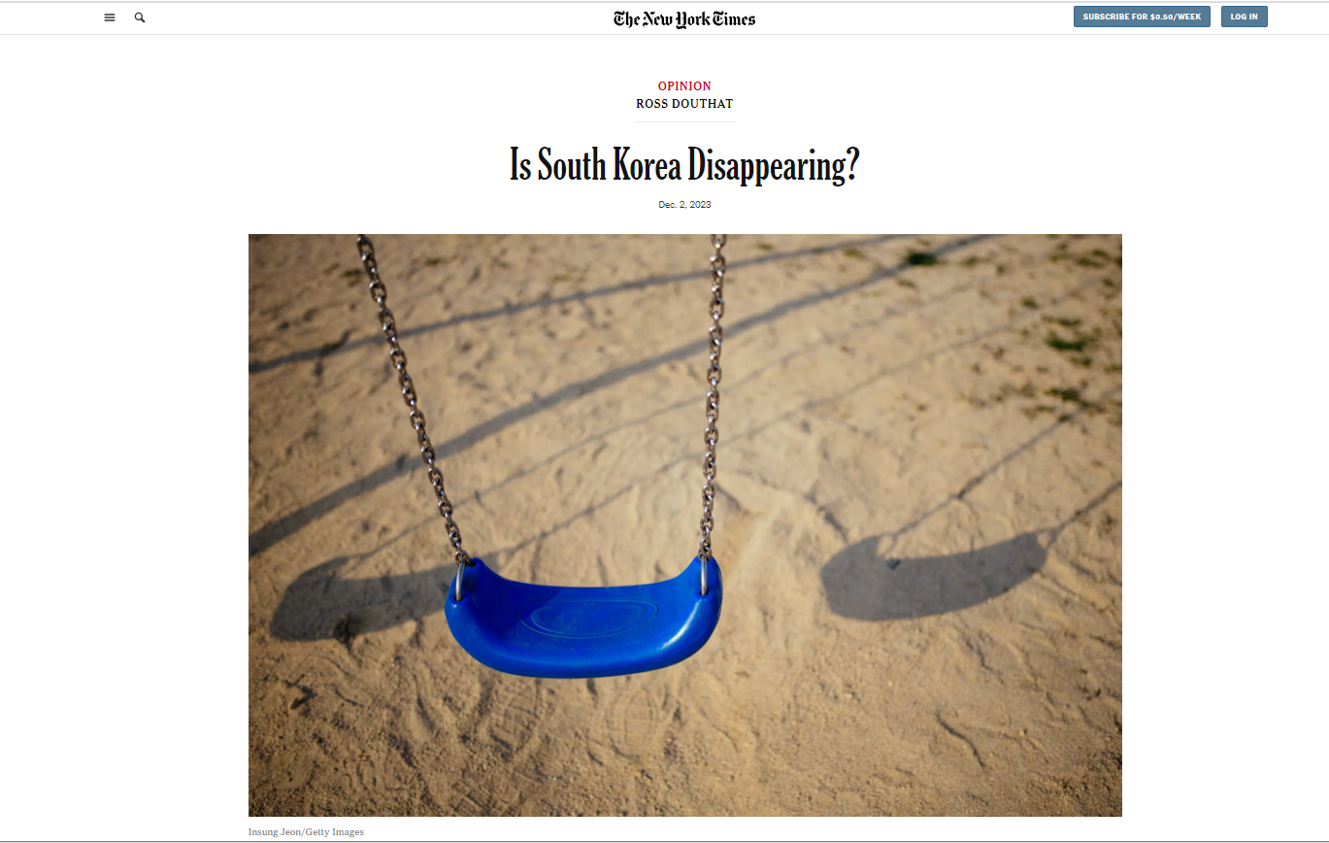
Immigration policy and programs are actively considered now
44/45
https://www.nytimes.com/2023/12/02/opinion/south-korea-birth-dearth.html

Slide 45
45/45
https://www.grammarly.com/blog/thank-you-so-much/

