Slide 1
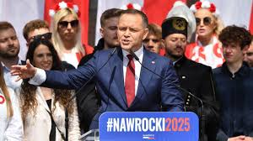
The 2025 Polish Presidential Election: What was Important in International Politics Today?
Akira ICHIKAWA (Ph.D.)
Professor, Toyo University

Slide 2
The Result of Run-off Vote of the 2025 Presidential Election in Poland

Slide 3
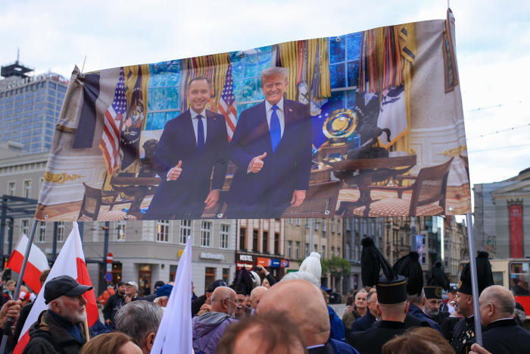
The Ruling Party’s Enemy was not Russia, but MAGA

Slide 4
Purpose and Scope of Today’s Lecture
To Confirm the Political Process Leading up to the First Round (May 18) of the 2025 Polish Presidential Election
The ruling party;
anticipates a confrontation with the opposition (PiS).
is concerned about Russian interference in the election.
anticipates a confrontation with the elderly conservative population in rural areas, who support PiS.
anticipates that Nawrocki will self-destruct due to scandals.
anticipates security through the “Weimar Triangle” with Germany and France.

Slide 5
Why is the Polish Presidential Election in 2025 Attracting so much Attention?
The President and the “Rule of Law”
Poland's Political System
The President is the Head of State
The Prime Minister leads the government
Executive power is formally divided between the two, but the President's authority is limited.
However, the President can veto legislative proposals or refer bills passed by parliament to the Constitutional Court for review, thereby countering the parliamentary majority.
President Andrzej Duda
Played a significant role in deepening the crisis of the “rule of law” in Poland
From 2015 to 2023, President Duda approved nearly all bills passed by the PiS (Law and Justice)-controlled parliament, leading to widespread reforms in the judiciary, prosecution, and other legal institutions.
After the October 2023 parliamentary elections resulted in a change of government and PiS became the opposition, President Duda became a major obstacle to reform efforts, directly opposing Prime Minister Donald Tusk and Justice Minister Adam Bodnar.
President Duda adopted a tactic to obstruct corrective measures by referring a key bill aimed at restoring the independence of the Constitutional Court and the National Council of the Judiciary to the Constitutional Court itself.
The outcome of the 2025 presidential election and changes in the power dynamics between the president and the government will be key to restoring the “rule of law” in Poland. (Skóra, Maria 2025.5.22)

Slide 6
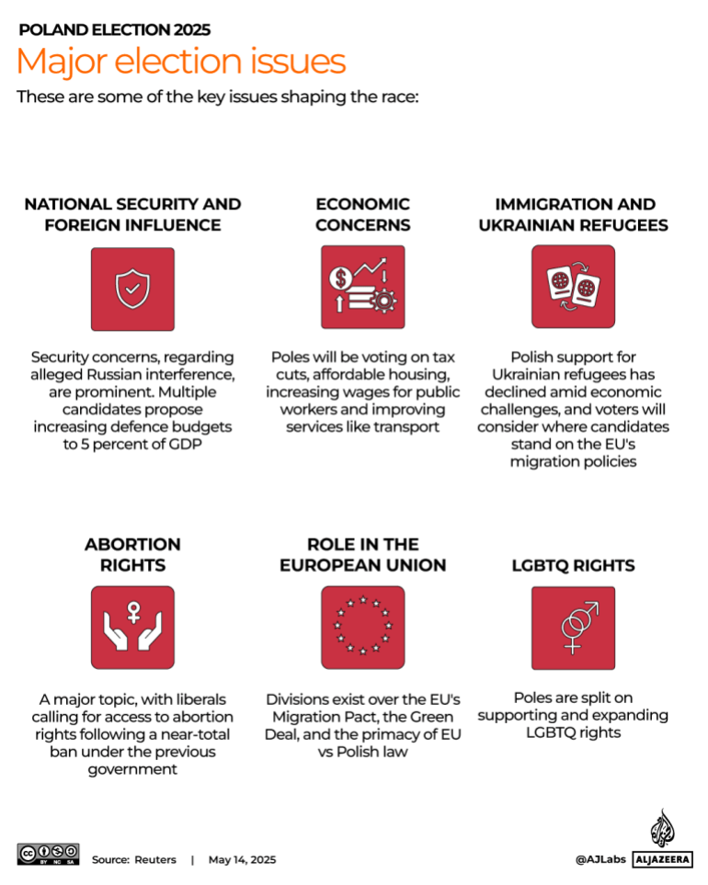
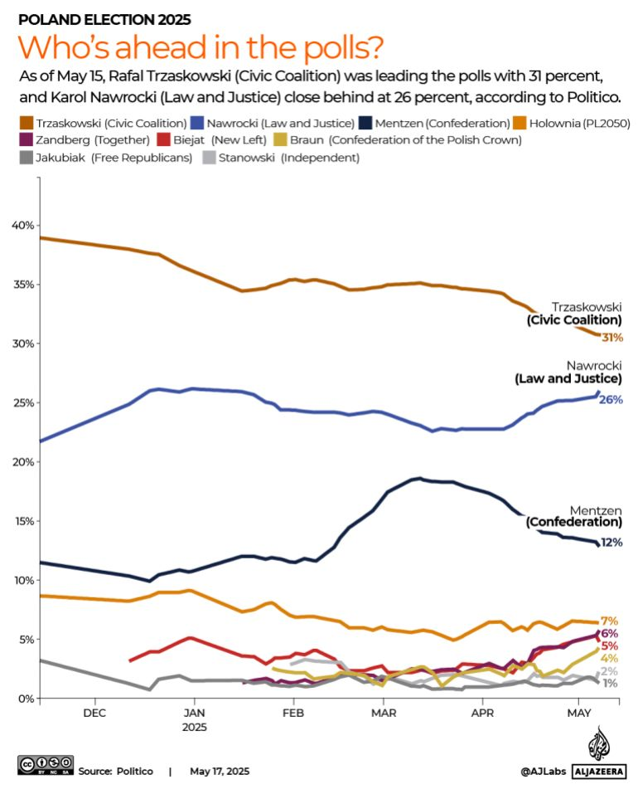
2025 Polish Presidential Election
January 15, 2025:
Start of Election Campaign
Al Jazeera(2025.5.17)

Slide 7
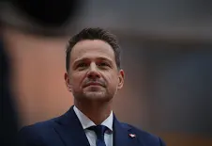
Leading Candidates (1)
Rafał Trzaskowski
53 years old
Mayor of Warsaw since 2018
During his tenure as Mayor of Warsaw, he received high praise for investments in the city's infrastructure and culture.
Deputy leader of the Civic Platform (PO) party led by PM Tusk
Narrowly lost the 2020 presidential election to Duda
He proposed increasing defense spending to 5% of GDP and developing Poland's weapons and technology industries.
Pro-European
Strengthening Poland's position within the EU
Support for the LGBTQ community
This could alienate some conservative voters outside urban areas.

Slide 8
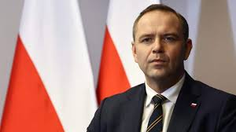
Leading Candidates (2)
Karol Nawrocki
42 years-old
An independent conservative historian supported by the PiS party.
His academic research focuses on anti-communist resistance movements.
Director of the Institute of National Remembrance
From 2017 to 2021; Director of the Museum of the Second World War
Anti-EU
Tax cuts
Withdrawal from the EU's immigration agreement and the Green Deal
Allocating 5% of GDP to defense spending
Critical of expanding rights for LGBTQ couples

Slide 9
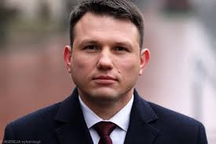
Notable Candidates (1)
Sławomir Mentzen
38 Years-old
Far-right entrepreneur leading the New Hope Party within the Confederation group.
He holds degrees in economics and physics
Owner a Brewery in Torun and running a tax consulting firm
Mentzen has used social media platforms to build connections with young voters.
Anti-EU
Poland should remain neutral in the Russia-Ukraine war.
The Polish Constitution takes precedence over EU laws
Poland to withdraw from the EU Green Deal.
Opposes LGBTQ rights and abortion even in cases of rape.
While Poland provides free higher education, Menzen proposed introducing tuition fees for national schools in late March, leading to a decline in his approval ratings in public opinion polls.

Slide 10
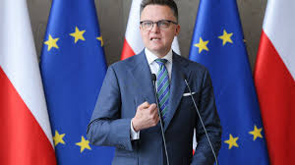
Notable Candidates (2)
Szymon Hołownia
48 Years-old
A former journalist and television personality
Currently chairperson of the Sejm
In 2020, he founded the centrist movement “Poland 2050”
Joining the coalition government led by Donald Tusk.
Promoting regional development
Improving access to affordable housing
enhancing public transportation systems
He also calls for reducing bureaucracy, supporting Polish businesses, and strengthening the country's domestic weapons production capabilities.

Slide 11
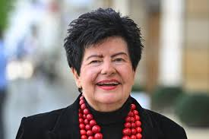
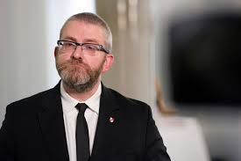
Non-serious Candidates
Magdalena Biejat (43)
Senate deputy chairperson
Women's rights, minority rights, affordable housing, and access to abortion
Adrian Zandberg (45)
Far-left
Similar campaign promises with Biejat
Joanna Senyszyn (76)
a former member of the Polish United Workers’ Party
Grzegorz Braun (58)
Far-right
faced international criticism in 2023 for extinguishing Hanukkah candles with a fire extinguisher in parliament.

Slide 12
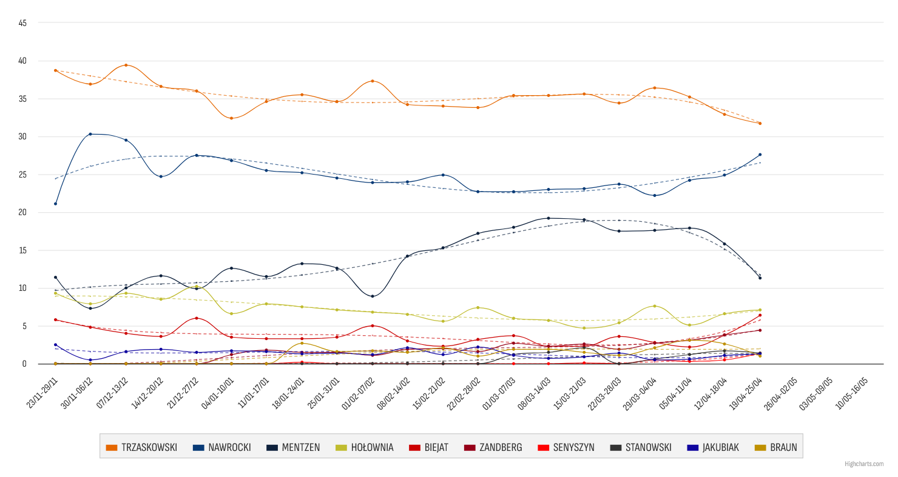
Chronology until the First Vote (1)
Karol Nawrocki
An unknown political outsider
Gains momentum due to controversial remarks by far-right candidate Mentzen

Slide 13
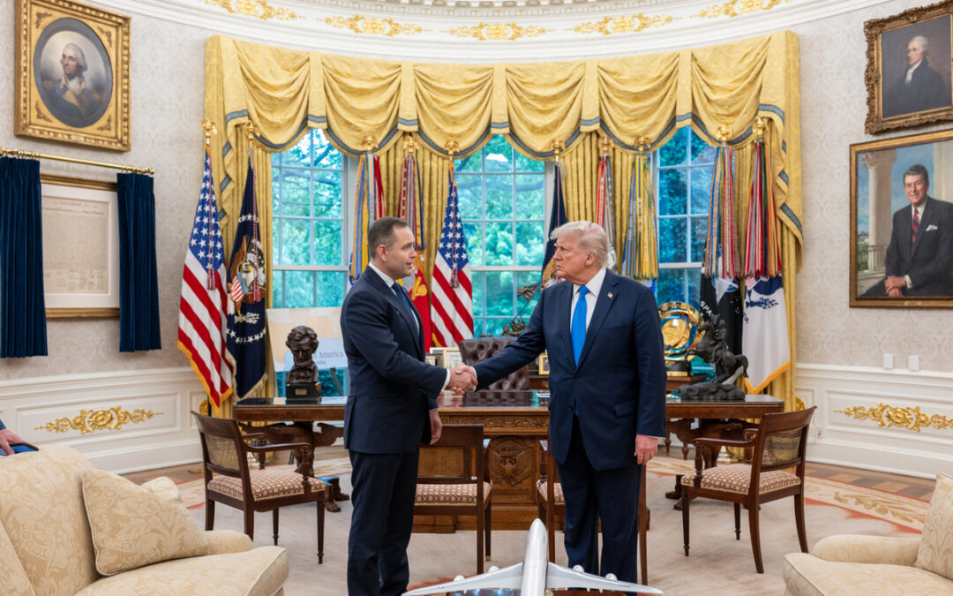
Chronology until the First Vote (2)
May 1, 2025: U.S. President Donald Trump invites Nawrocki to the White House
Donald Trump
“You will win the Polish presidential election.”
Elżbieta Witek
PiS
“Karol Nawrocki is the only candidate who can guarantee Poland's security and maintain a strong alliance, especially during difficult times with the United States.”
Roman Giertych
Chairperson of the Lower House
“The fact that the Trump camp, which is close to Putin, attempted to influence the Polish presidential election demonstrates a colonial attitude toward Poland.”

Slide 14
Chronology until the First Vote (3)
May 1, 2025: U.S. President Donald Trump invites Nawrocki to the White House
Donald Trump
“You will win the Polish presidential election.”
Elżbieta Witek
PiS
“Karol Nawrocki is the only candidate who can guarantee Poland's security and maintain a strong alliance, especially during difficult times with the United States.”
Roman Giertych
Chairperson of the Lower House
“The fact that the Trump camp, which is close to Putin, attempted to influence the Polish presidential election demonstrates a colonial attitude toward Poland.”

Slide 15
Chronology until the First Vote (4)

Slide 16
Chronology until the First Vote (5)
Political Maneuvering
May 2: Nawrocki in real estate scandal
Accused of offering funds to elderly residents in Gdansk in exchange for caregiving, enabling them to purchase public housing at discounted rates. After obtaining ownership, he allegedly failed to provide the promised care.
May 6: European Parliament
strips Grzegorz Braun of parliamentary immunity
This paves the way for potential charges related to seven cases from 2023.
May 6: Krzysztof Gawkowski, Digital Minister
warns of unprecedented Russian interference in Poland's presidential election.
May 6: President Duda
refuses to sign a bill reducing health insurance premiums for business owners.
May 7: Constitutional Tribunal
rejects the 2025 budget.
May 7: Remains of 42 Polish victims believed to be from the Volhynia massacres
discovered in the Ukrainian village of Puzhnyky
May 9: Government
launches free preventive healthcare program for those aged 20 and older

Slide 17
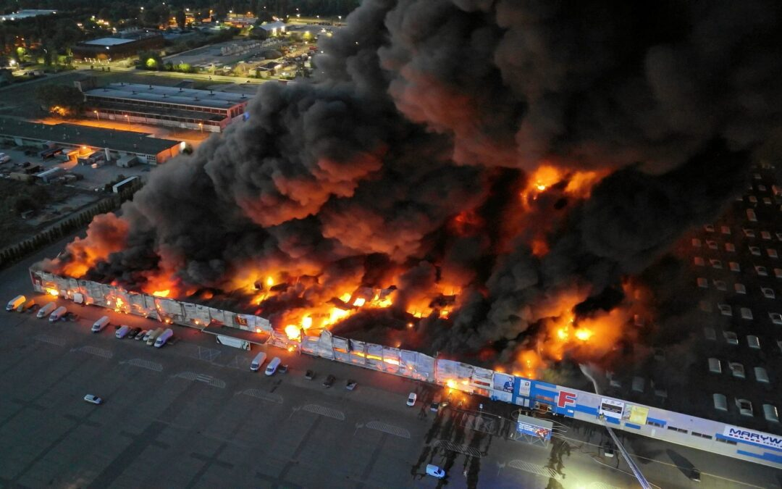
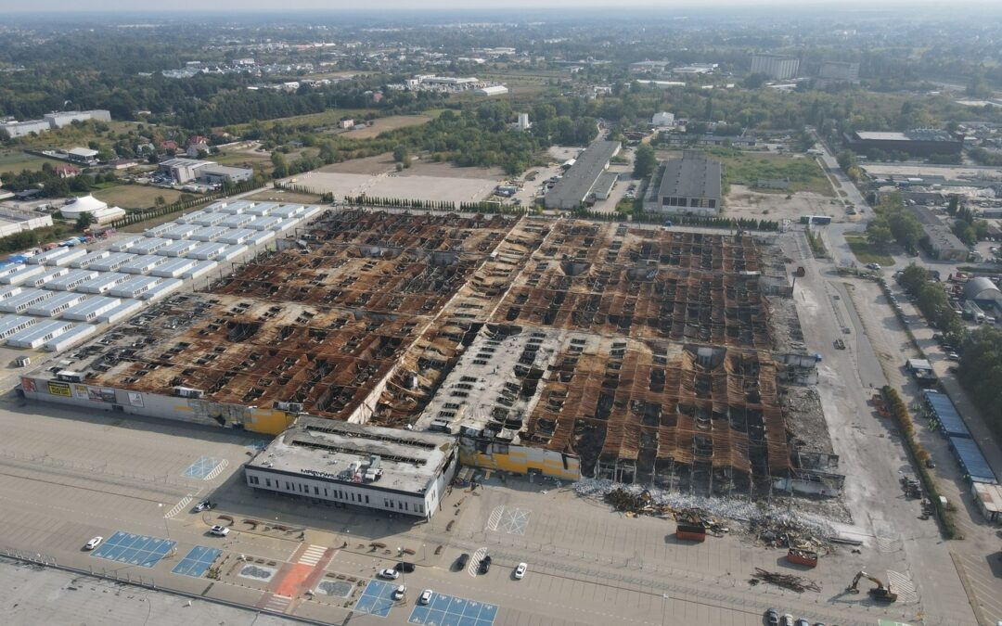
Chronology until the First Vote (6)
May 11, 2025:
Government says that the Marywilska 44 shopping center fire on May 12, 2024 was ordered by Russia.

Slide 18
Chronology until the First Vote (7)
2025.5.13: Romanian presidential candidate George Simion allies with Nawrocki.
Tusk criticizes the alliance between pro-Russian Simion and Nawrocki.
2025.5.14: NASK (National Agency for Cyber Threat Monitoring)
warns of Facebook ads funded by foreign sources.
ABW (Internal Security Agency) investigates the organizations and funding behind them.
Possibility of ties to Rafał Trzaskowski's support group.
2025.5.15: NIK (Supreme Audit Office)
reports that 95% of subsidies to religious organizations during the PiS government went to the Catholic Church.
2025.5.16: PM Tusk
announced that Russian hackers had targeted the websites of the ruling coalition parties.
2025.5.18: Ukrainian intelligence
warns that Russian disinformation is influencing Polish presidential election
“No candidate has enough votes to avoid a runoff between the two top candidates. The PiS, led by 75-year-old Jarosław Kaczyński, and Tusk‘s PO are the two major parties that have dominated Polish politics for the past 20 years, and some voters are fed up with their duopoly.” （Easton, Adam: May 17, 2025)

Slide 19
The Result of the First Vote (1)

Slide 20
The Result of the First Vote (2)

Slide 21
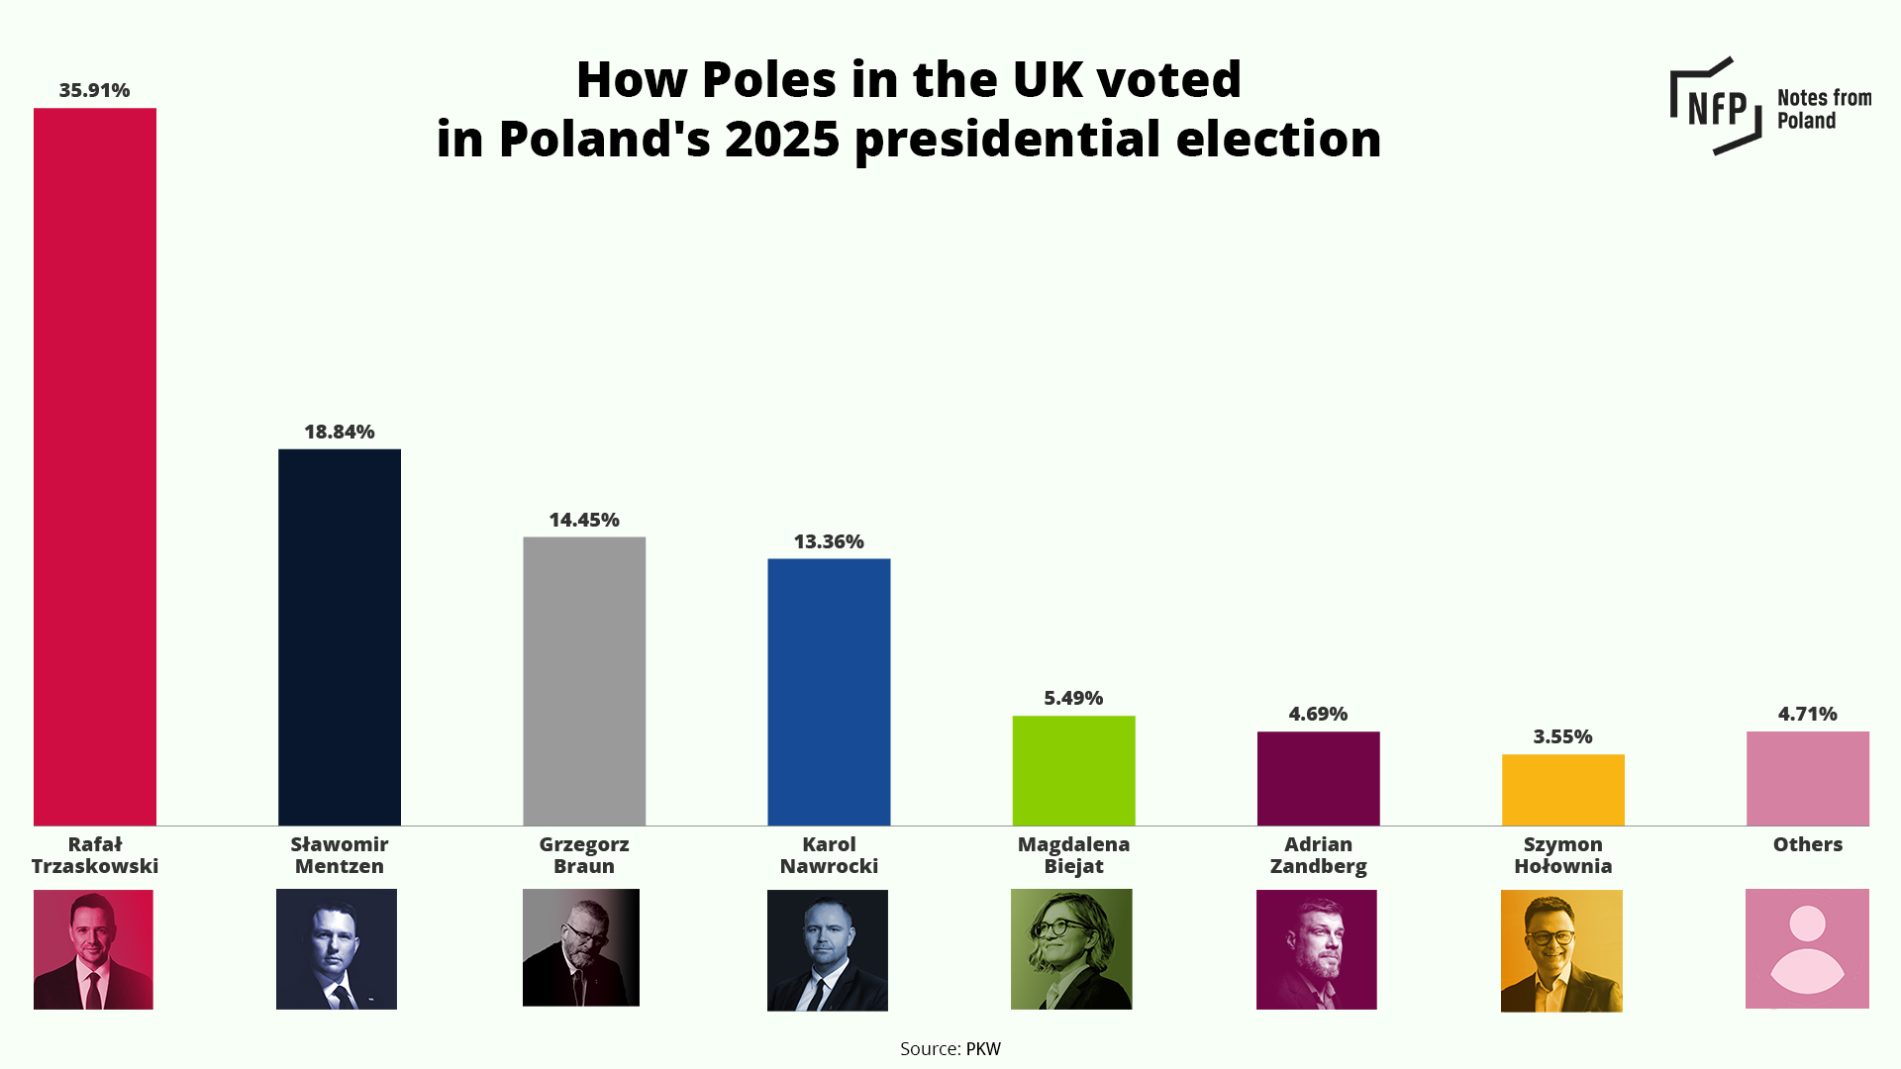
The Result of the First Vote (3)

Slide 22
The Result of the First Vote (4)

Slide 23
The Result of the First Vote (5)

Slide 24
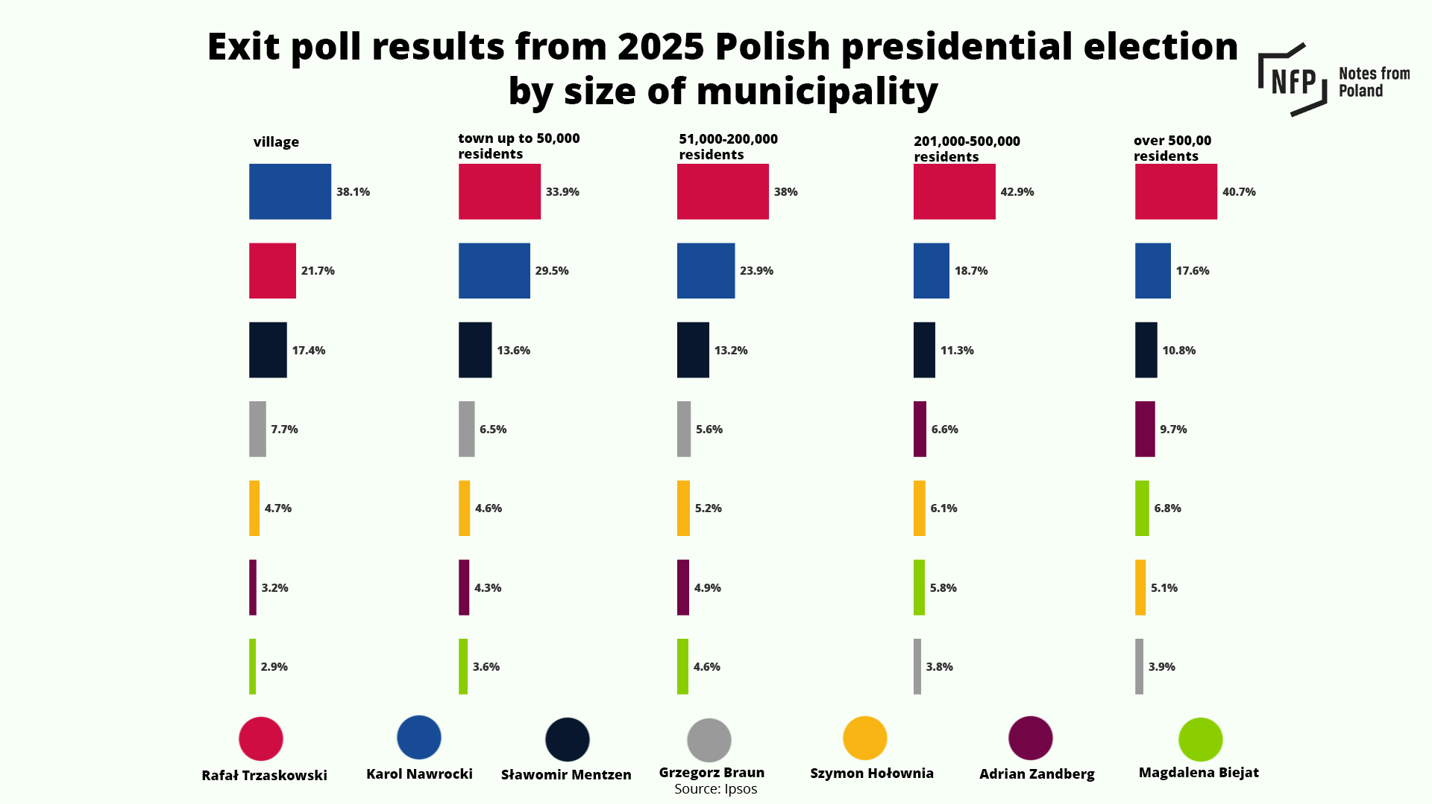
The Result of the First Vote (6)

Slide 25
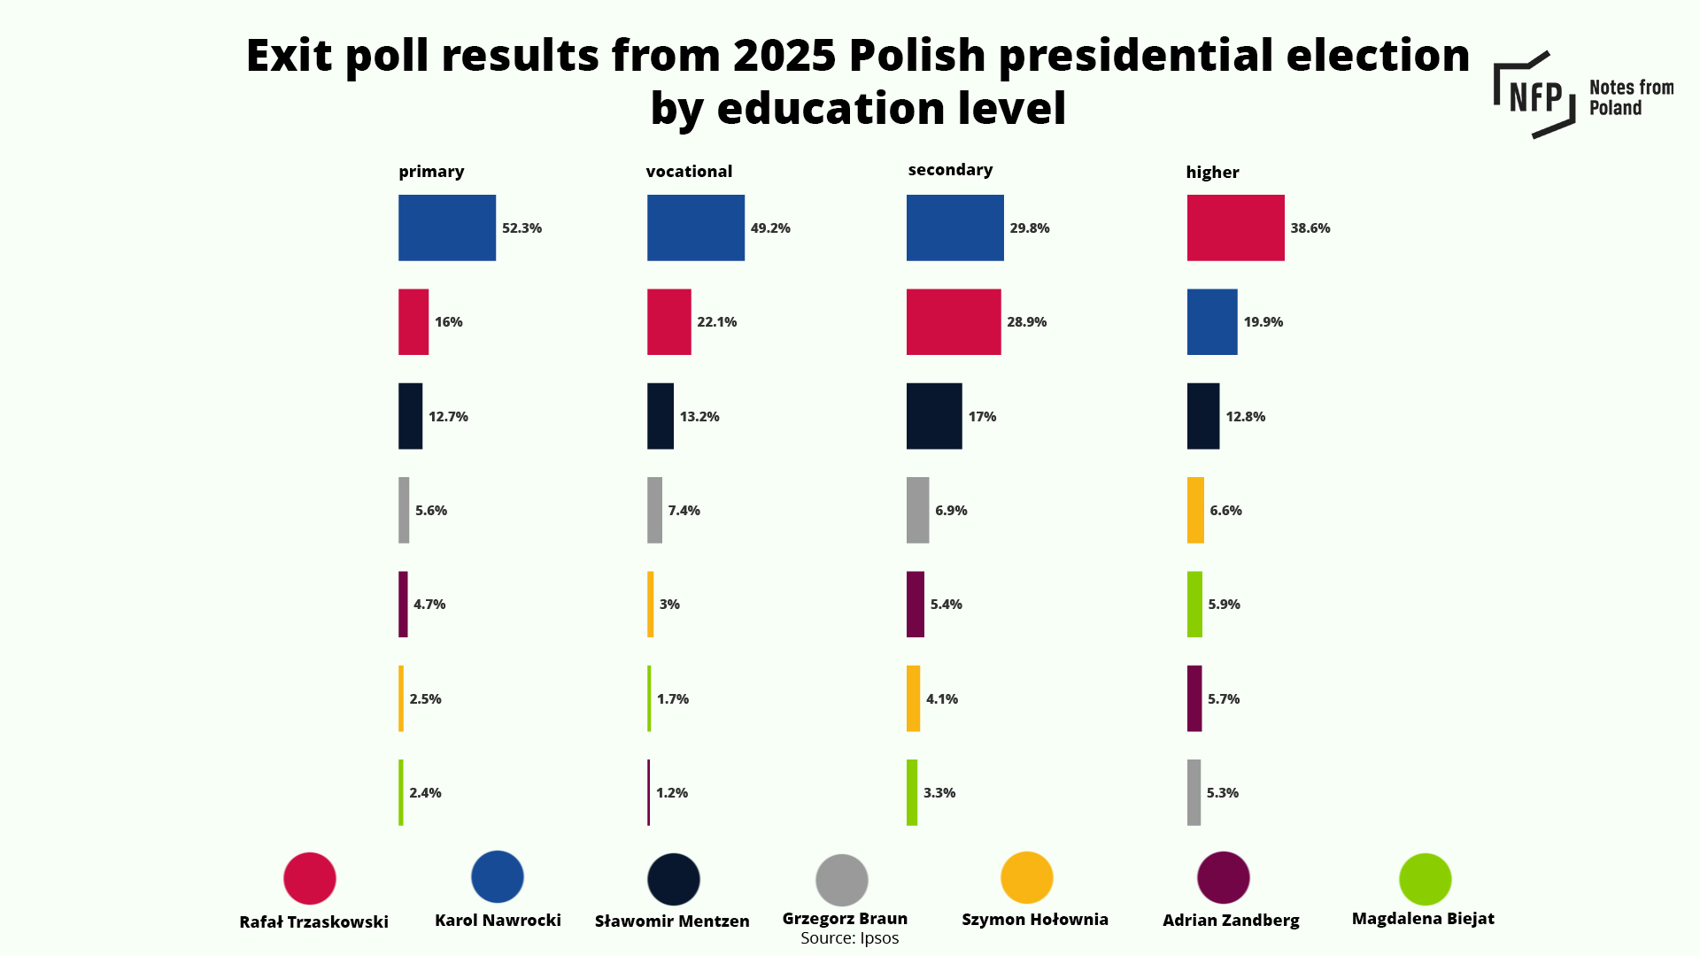
The Result of the First Vote (7)

Slide 26
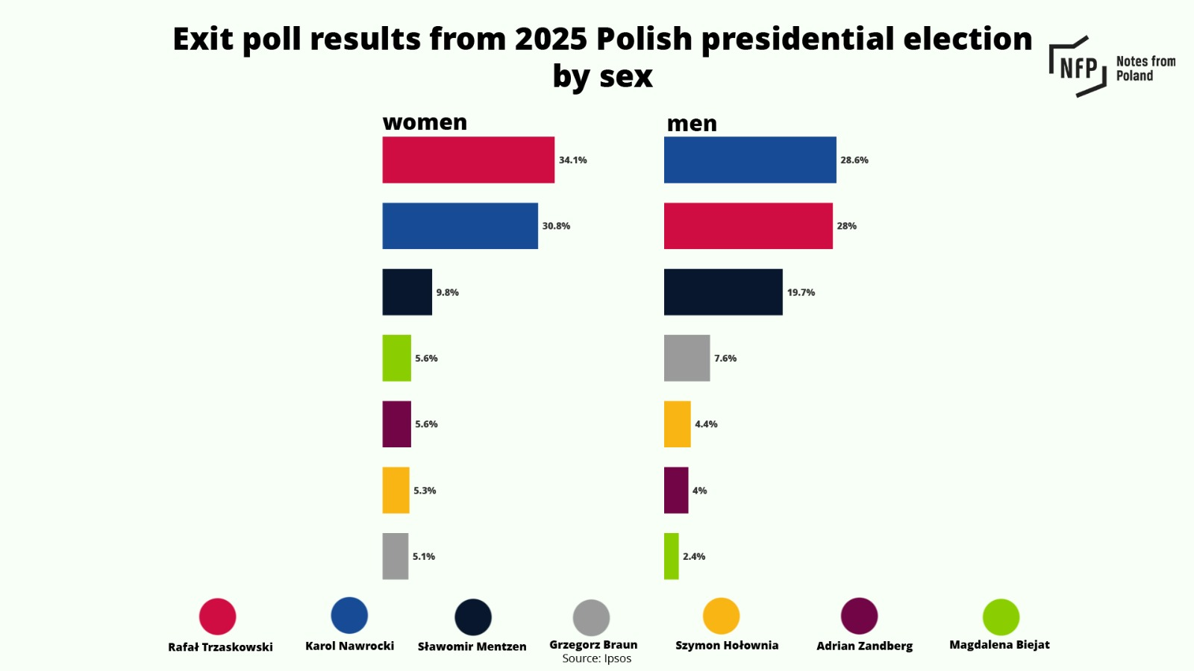
The Result of the First Vote (8)

Slide 27
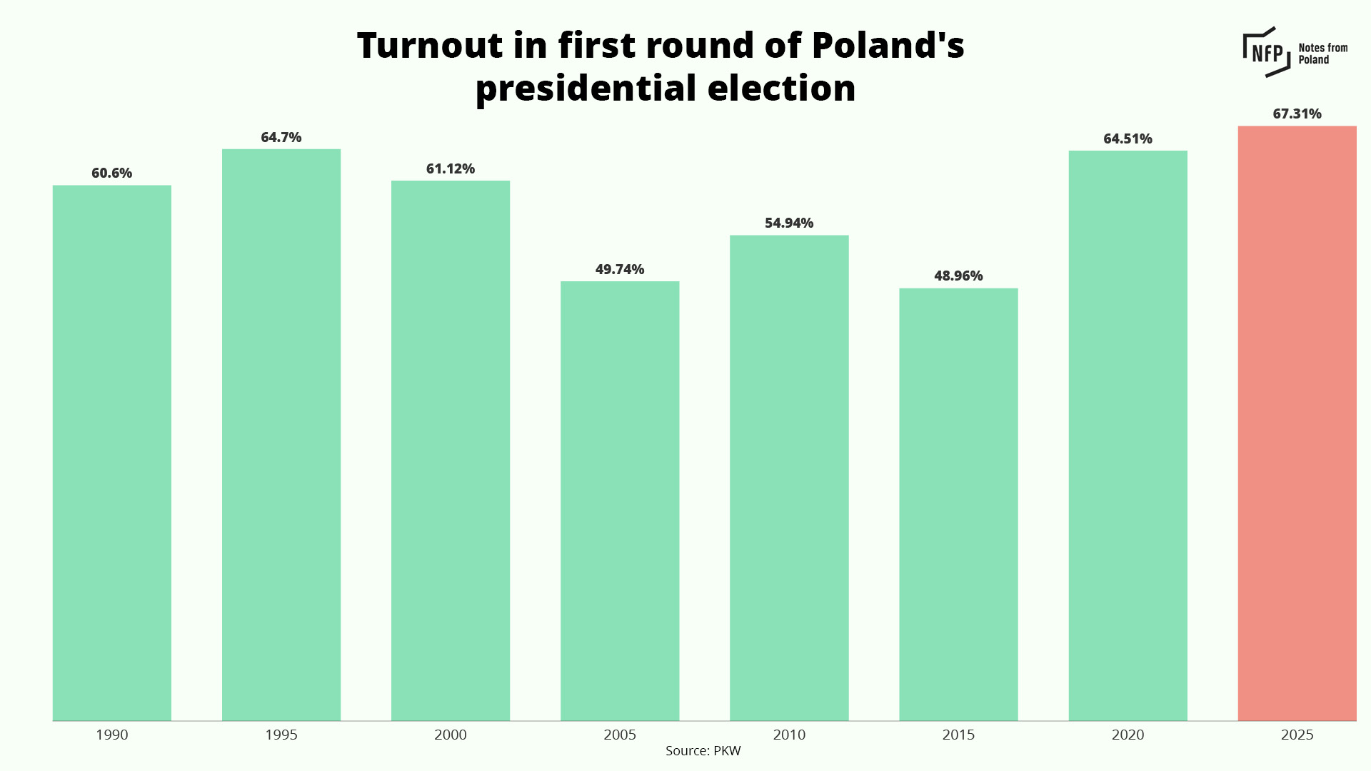
The Result of the First Vote (9)

Slide 28
The Ruling Party’s Miscalculation
The ruling party's enemy;
was the public's growing dissatisfaction with the two-party system
was election interference by the MAGA base
was young people in the internet age (especially those living in the eastern states, with lower education levels, and male)
was Nawrocki, who had scandals but OUTSIDER
was the public with anti-EU sentiments seeking security from the United States

Slide 29
Things to Clarify by the Next Lecture
Why was Nawrocki able to overturn the results in the run-off election?
In what ways did MAGA's election interference continue?
What implications do the results of the run-off election have for previous discussions on populism in Central and Eastern Europe?
What impact could the results of the runoff election have on the 2027 Polish parliamentary elections?
Will Poland become a proxy battleground between the US and the EU?
How will Nawrocki's presidency affect Poland's support for Ukraine?

